Slide 1
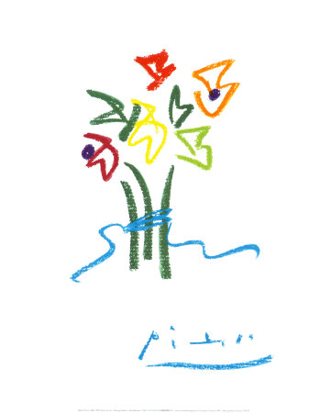

A PhD is Not Enough
Life Beyond Piled Higher Deeper
Huizhi (Elly) Liang
Research Fellow of Faculty of Science and Technology, QUT
CSD HDR Consortium 2011
HDR Training Workshop

Slide 2
Agenda
Research Topics
PhD Life
Post Doctoral Life
Top 5 tips

Slide 3
Research Topics
Topics
  Recommender Systems (Amazon.com, Netflix.com)
  Web 2.0 (Folksonomy, Micro-blogs, Social Networks)
  Data Mining, Information Retrieval
Supervisor Team
  PhD: A/Prof Yue Xu, Prof Yuefeng Li, A/Prof Richi Nayak
  Postdoc: A/Prof Dian Tjondronegoro

Slide 4
PhD Life
Study Milestones
  Commenced: 08/2007; Thesis Submitted : 11/2010; Completed: 04/2011
Research Outcomes
  Nominee of University Outstanding Thesis Award
  Publication: 11 papers (3 ERA Tier A conference paper)
  Grants
    Write-up Scholarship 2010 & Grant-in-Aid 2009
    Queensland Cyber Infrastructure Foundation (QCIF, $5000) 2010
    SIGWEB 2010 & Society for Industrial and Applied Mathematics (SIAM) 2010
    Australian Research Council Network in Human Communication Science 2007
    Cloud Computing Internship 2010 (8 weeks, 500AD/week)
  Trips
    4 National conference trips
    3 International conference trips: Italy 2009, Canada 2010, USA 2010

Slide 5
PhD Life 2
Other Experiences
  Teaching (2008- 2010)
  Services
    Volunteer of conferences
    Paper reviewer
  Life
    Books, Movies, Music
Recommendations
  Piled Higher Deeper (http://www.phdcomics.com/)
  Ted (http://www.ted.com/)
  Yale Open Courses (http://oyc.yale.edu/courselist)
  MIT Open Courses (http://ocw.mit.edu)

Slide 6
Postdoctoral Life
Work (Commenced : 02/2011)
  Research & Teaching & Coordinating
Job Hunting
  Prepare
    CV
    Response to Selection Criteria
    Research Statement & Teaching Statement (USA)
  Job Advertisements
    Geographic Location & Job Orientation: Industry & Academic
    Websites: (seek.com, unijobs.com.au, cra.org, phds.org)
    Email list: SIGIR email list
  Promote yourself
    Personal Website (20AD/year) & Conferences
    Professional social network websites (LinkedIn, Facebook)
Recommendations (books)
  Tomorrow’s Professor & A PhD Is Not Enough

Slide 7
Top 5 Tips
Top 5+1: Study English Everyday & Read English Books
Top 5: Attend Seminars & Ask Questions
Top 4:Talk to People About Your Research (HPC)
Top 3: Connect to Your Research Group (RecSys gmail group)
Top 2: Organize Your Supervisors
Top 1: A story of 3 stonemasons
First man: I'm chiselling a stone.
Second man: I'm building a pillar.
Third person: I'm building a church.

Slide 8
Thanks
www.ellyliang.com
oklianghuizi@gmail.com

